Slide 1
GENERATOR DESIGN: BENTHIC MICROBIAL FUEL CELLS for Long term Sensors Networks
Brandon Kelly
Mentored by dr. Jordon Beckler
FAU reu for renewable energy
7/14/2022

Slide 2

Power Generation
4 mV drop across 47 Ω
Ohm’s Law: V=IR=>$I=\frac{V}{R}$
Power Equation: P=IV
P=$\frac{V^{2}}{R}$=>$\frac{{.004}^{2}}{47}$=
.34 μW

Slide 3
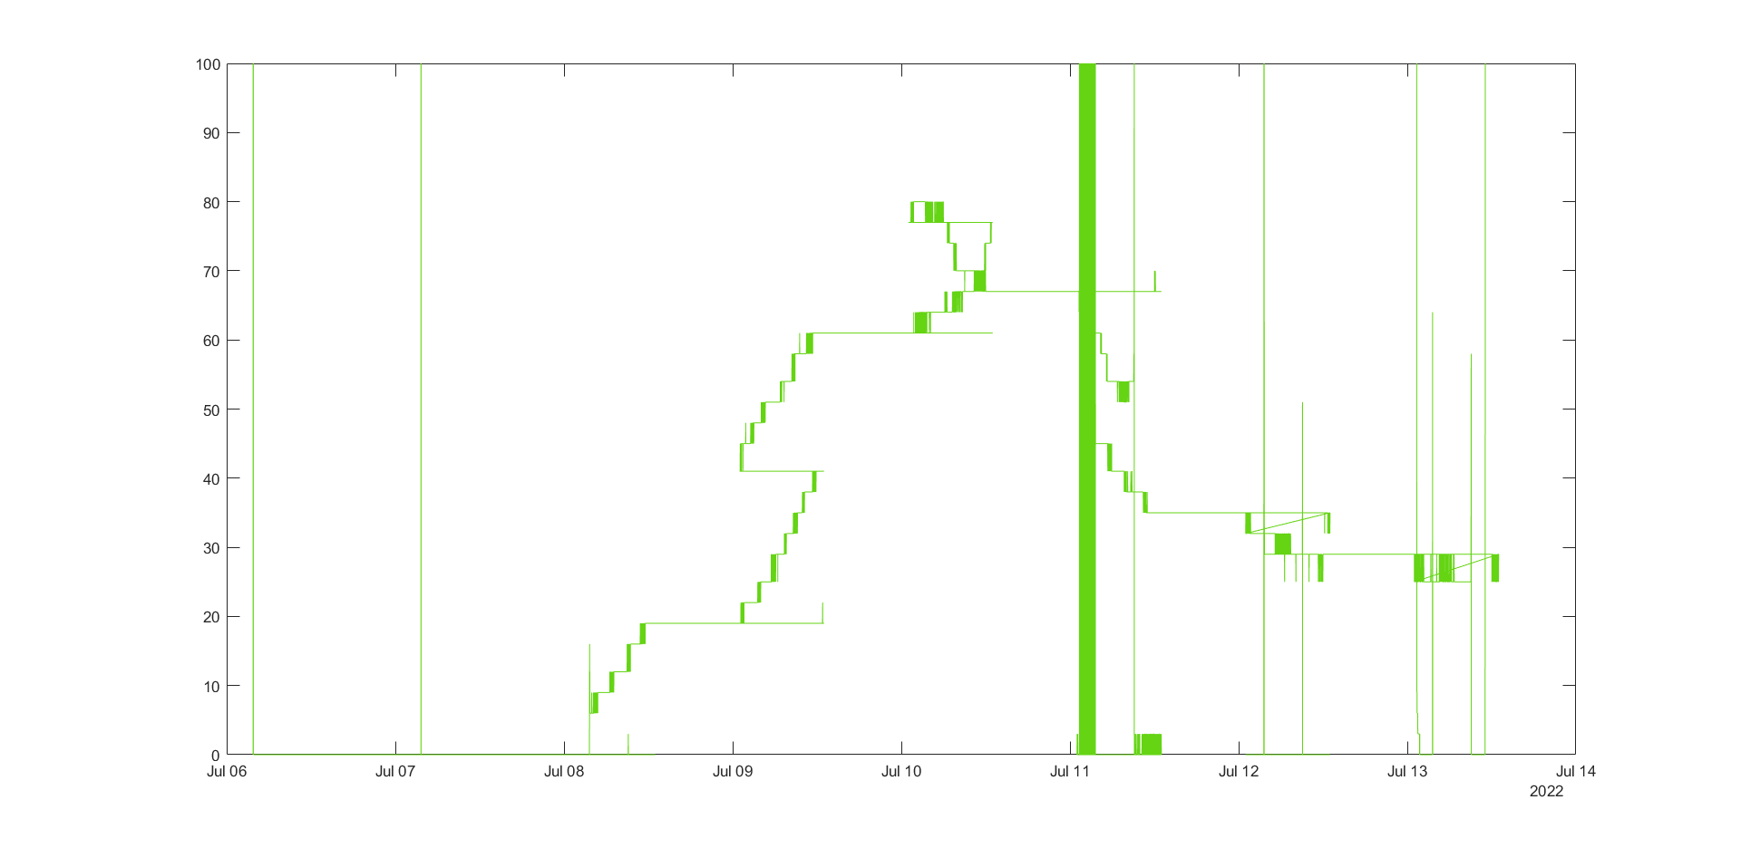
Data monitoring

Slide 4
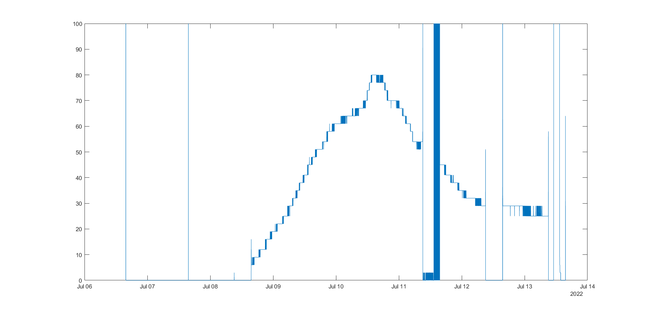
And Data Cleaning

Slide 5
Paper preparation
Reading Literature
Education
Fuel Cells
Researching Journals
Generating Outline

Slide 6
Switching Battery Chemistry
Working on switching to LiFePo₄ batteries
Less Reactive Chemistry
Simpler to Charge
More resilent

